Slide 1
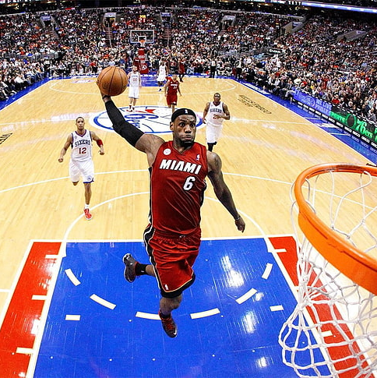
Predicting Clutch Performance in the NBA Using Machine Learning
A Data-Driven Look into “Being Clutch”
Mahim Dahal, Michael Freda

Slide 2
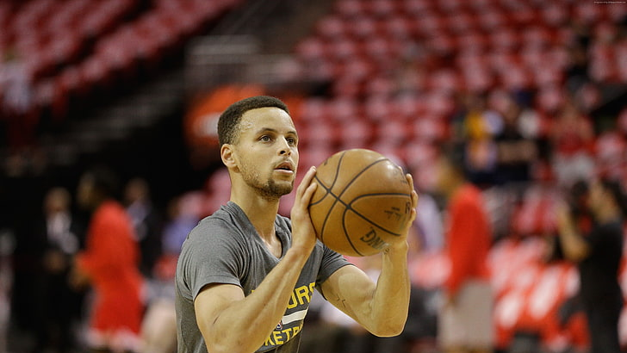
Introduction
What is “Clutch” in the NBA?
Final 5 minutes of a close game (≤ 5 point margin)
Why does it matter?
Influences reputations, careers, and scouting decisions
Main Question:
Can regular season stats predict clutch-time performance?

Slide 3

Data Collection
Source: Official NBA Stats API (2000–2024)
Tools: Python and nba_api
Endpoints Used:
LeagueDashPlayerStats – Regular season stats
LeagueDashPlayerClutch – Clutch-time stats
Clutch Definition:
Last 5 mins of games within 5 points

Slide 4
Methodology
Clutch Performance Target Variable:
We defined clutch scoring efficiency as PTS_per_FGA_delta (i.e., change in points per field goal attempt between clutch and regular play).
Normalization:
All player stats were normalized to per-minute values to ensure comparability regardless of total playtime.
Delta Calculation:
For each player and season:
We calculated the difference between clutch and regular values for:
Field Goal Percentage (FG_PCT)
Points, Assists, Rebounds, Turnovers
Plus-minus stats
These deltas aim to capture performance shifts under pressure.
Filtering:
We only included players with enough clutch-time data to avoid noise from rare events.

Slide 5

Model Used
Tried different regression models
Random Forest Regressor gave the best performance
Handled non-linear relationships
Captured interactions between features (e.g., FG% and usage rate)
More robust to outliers and noise
Used GridSearchCV to find:
Optimal number of trees
Maximum depth
Minimum samples per split

Slide 6
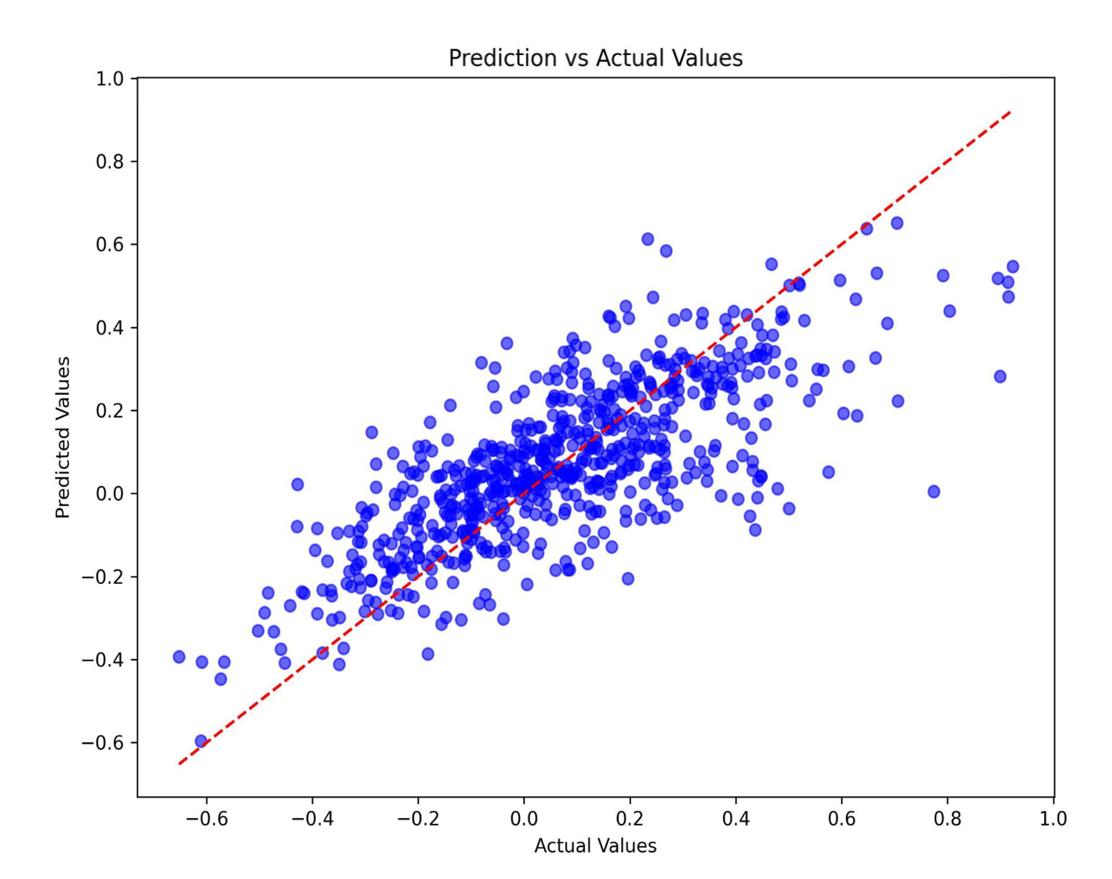
Model Performance & Interpretation
Each dot = a player’s predicted vs actual clutch efficiency gain
R² score: 0.57 – model explains ~57% of variation
RMSE: 0.175 – relatively low prediction error
Predictions mostly align with actual values
Shows that regular season stats hold predictive value for clutch moments

Slide 7
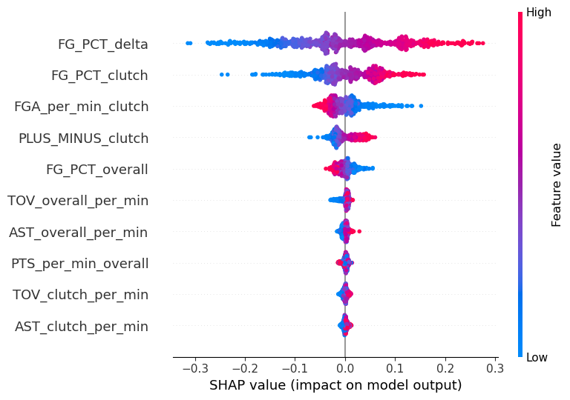
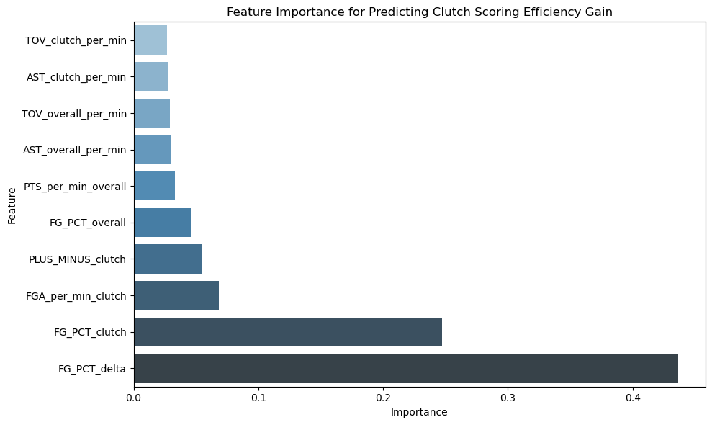
Feature Importance bar chart + SHAP plot
FG_delta (change in FG% from regular to clutch) is the most important feature
Players who take more shots and have better plus-minus in clutch time score higher
The bar chart shows which stats the model relied on most
The SHAP chart shows how high or low each stat affects the prediction
High clutch FG% increases predicted scoring efficiency
High regular FG% doesn’t always lead to better clutch performance

Slide 8
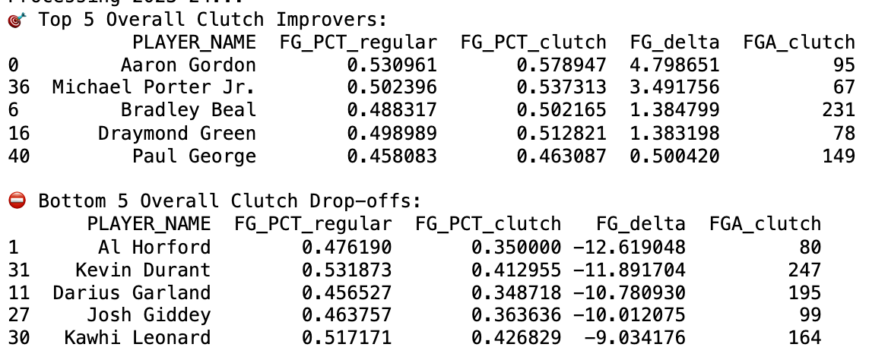
Real NBA Clutch Performance (2020–2024)
Analyzed clutch shooting performance across 4 full NBA seasons (2020–21 to 2023–24) for 50 top players.
FG_delta shows how much a player’s shooting improved or declined in clutch time (last 5 minutes, close games).
🔺 Top improvers include Aaron Gordon and Michael Porter Jr., who shot better in pressure situations than they did overall.
🔻 Biggest drop-offs include Kevin Durant, Kawhi Leonard, and Darius Garland — whose clutch FG% was significantly lower.
Supports model finding that FG_delta is a powerful predictor of clutch-time scoring efficiency.
Adds real-world credibility and connects model output to actual player behavior on the court.

Slide 9
Limitations & Future Improvements
Small sample size risk: Many players take only a handful of shots in clutch situations per season, which makes their FG% in those moments highly variable and less statistically reliable.
No shot difficulty included: The model treats all field goals the same — contested threes and open layups are weighted equally.
Clutch ≠ only scoring: Key clutch contributions like defense, passing, or leadership aren’t reflected in shooting stats or the model.

Slide 10
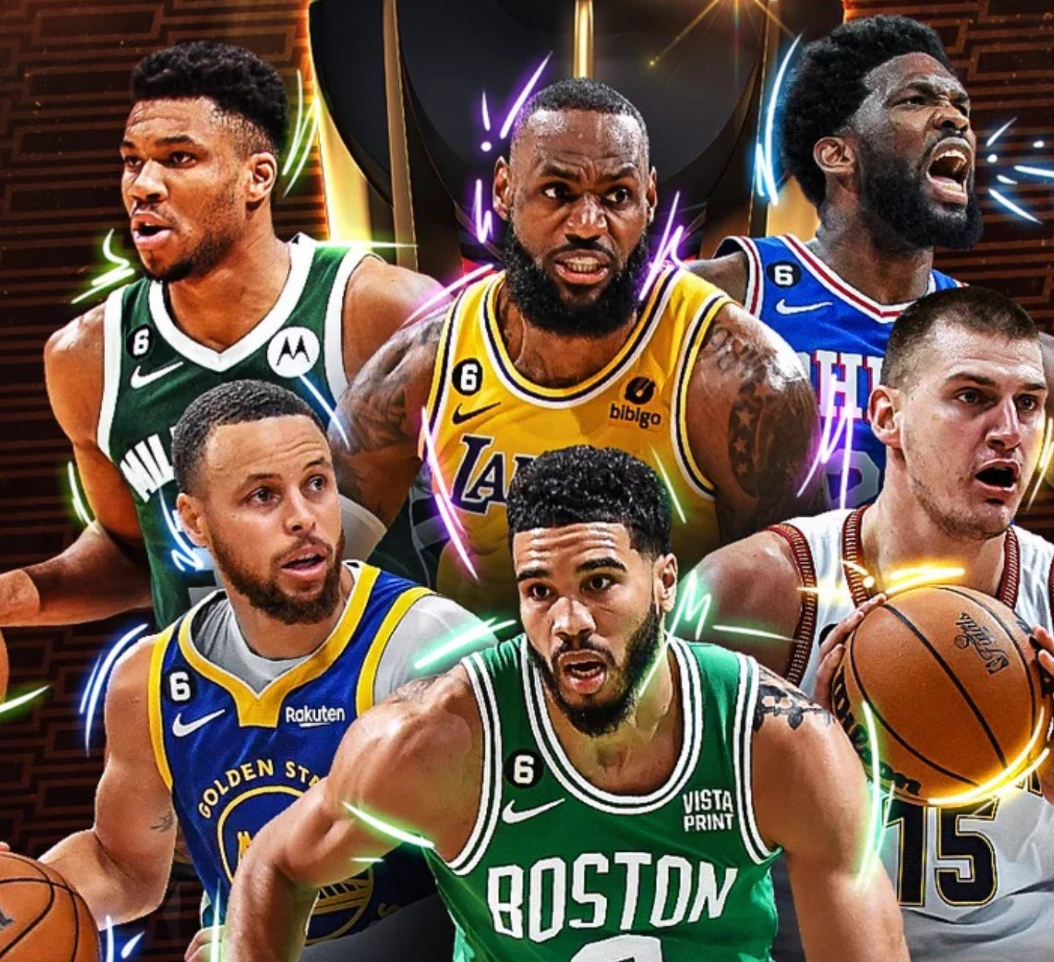
Where This Could Go Next?
Include playoff data for higher-pressure clutch situations
Analyze shot difficulty using tracking data or shot zones
Add non-shooting features: turnovers, assists, defensive stops
Test more models (e.g., XGBoost, LSTM for play sequences)
Predict clutch team-level performance instead of individual

Slide 11
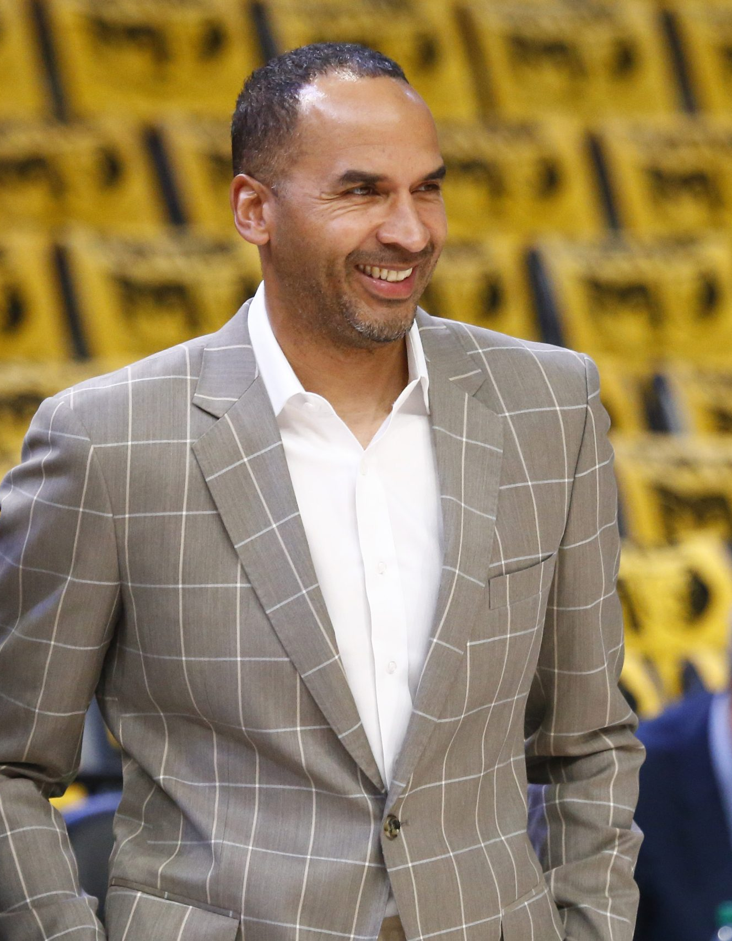
Implications For Stakeholders
Coaches can rely on clutch-specific stats to guide late-game decisions, not just overall averages
Front offices can avoid overrating players by looking at efficiency changes under pressure
Scouts can find underrated players who thrive in close games based on usage and impact
Players can use these insights to improve shot selection and composure in clutch moments
Fans and media get a data-based view of “clutchness”, beyond just big moments and narratives

Slide 12
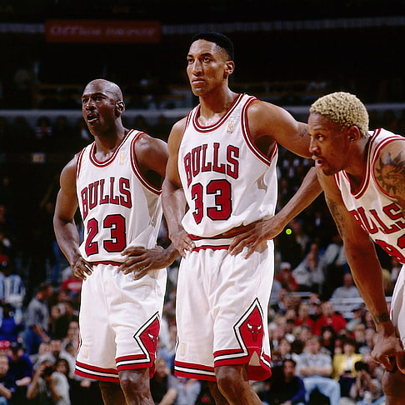
Ethical,legal and societal implications
Using models to judge players risks overlooking personal traits like leadership and mental resilience
Bias in data can unfairly impact how lesser-known or low-usage players are evaluated
Public stats may be used in ways players didn’t consent to, especially in contract or reputation decisions
Overreliance on analytics could shift how society defines “clutch,” potentially reshaping careers and legacies
It’s important that teams combine data-driven insights with human judgment to avoid reducing players to just numbers

Slide 13

Questions?

